Slide 1
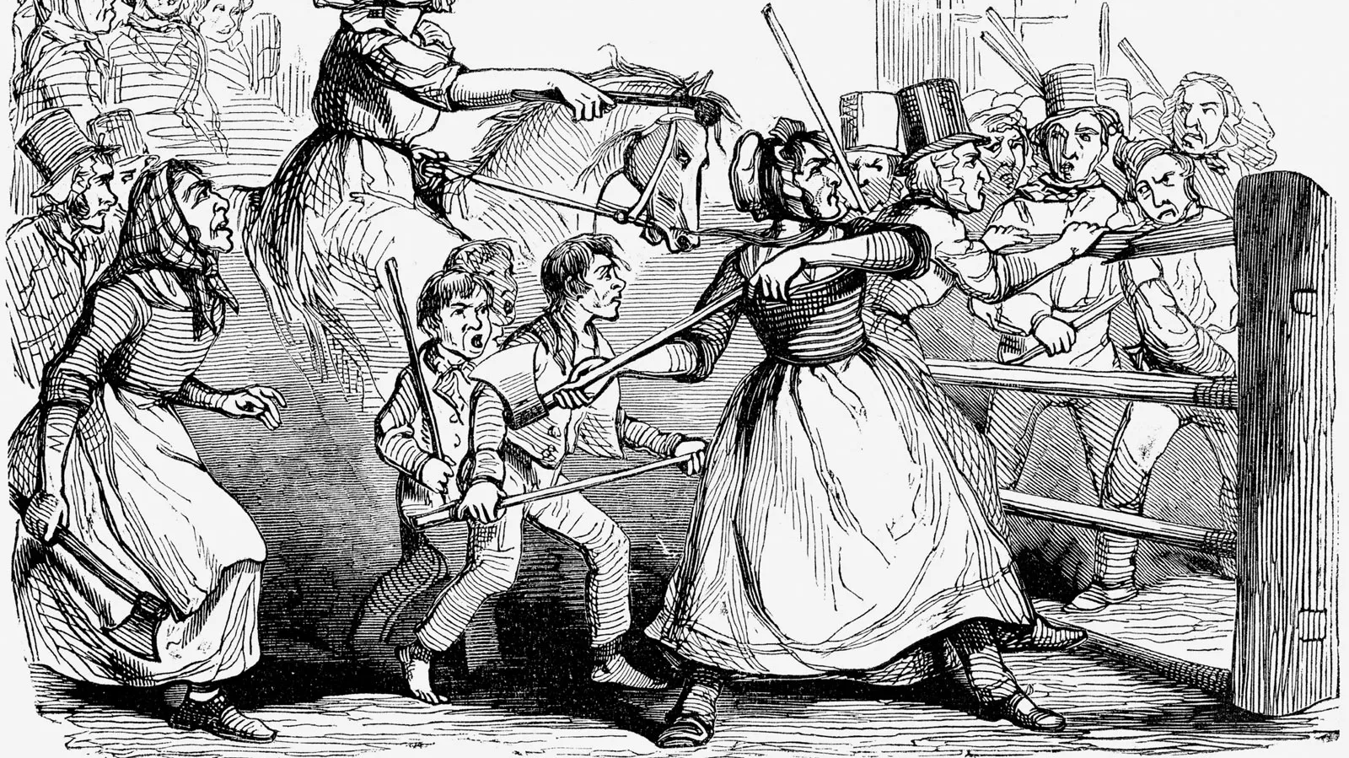
The Rebecca Riots
Toll and Error
© Photos.com/Thinkstock
Notes:
Introduce self and mention that this is a project for my final year of uni

Slide 2
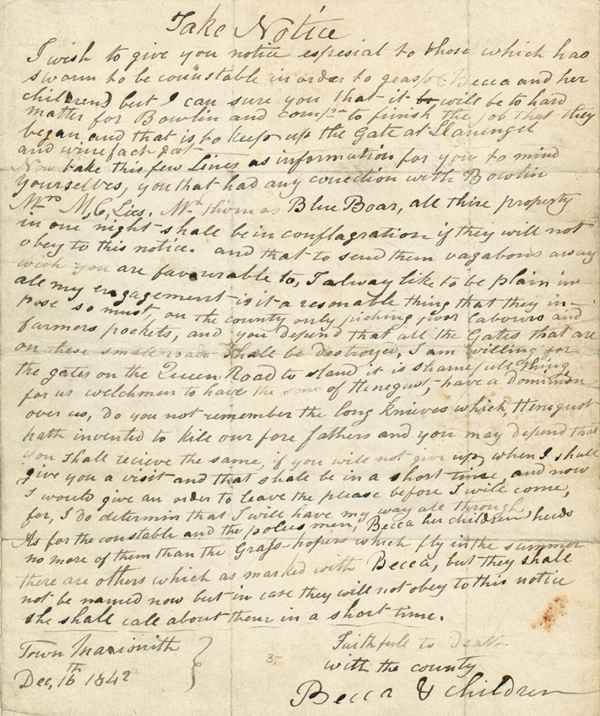
What were the Rebecca riots?
The Rebecca Riots were a series of protests against the rising cost of toll roads. They involved people, usually men wearing traditional Welsh women's wear, refusing to pay the tolls at the gates and calling themselves “Rebecca” or a “Daughter of Rebecca” to avoid being traced. In some cases this led to the toll gates being torn down by the rioters.
Notes:
Essentially say what is on slide. Comment on the letter, summarizing it. “The letter is a warning from "Becca & children" to those who tried to catch them. The writer threatens to burn their property and destroy gates on small roads. The writer claims it is shameful for Welshmen to be ruled by the sons of Hengist and threatens violence against those who do not obey the notice.”

Slide 3
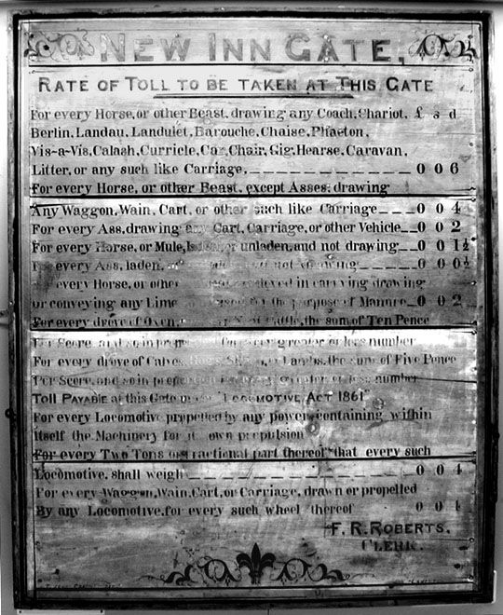
What is my project going to be?
My project is going to be a game made in GameMaker retelling this story. In it, you will play as a (fictional) toll collector, using the prices from the toll board in the museum, the player will have to collect tolls from people trying to pass the gates, until Rebecca and her daughters start to appear. The player will then have to decide. Do they want to help them or hinder them?
Notes:
Summarise slide, mention horrible histories for the tone before switching to the next slide

Slide 4
What is my project going to be?
Lighthearted, and hopefully even funny, but based on real events.
Mostly story based, but with some gameplay elements.
Will have two endings depending on your choices.
Full of different characters trying to use the toll road.
Notes:
Comment on each point. Lighthearted because I want the game to actually be fun to play and not make the player sad, story based so we can actually tell the story of the riots, but I want it to be interactive too. Different endings so playing the game twice is still interesting, different characters and their different cargo mean you have to figure out the toll needed for a wide variety of characters.

Slide 5
Technical work I have done
A mock-up of the GUI (Will be hand-drawn later on in development)
Wireframe of the GUI
Test game with GameMaker
Multiple meetings with museum staff to discuss the project

Slide 6
Technical Issues
Issues with setting up GameMaker (Failed to locate graphics drivers)
Finding my way around GameMaker was difficult to begin with, but became easy after creating a pre-made tutorial game.
I am happy with the technologies chosen so far, but may use different software to create the artwork for the game. I will decide if GIMP is fit for purpose or not when I get to that point.

